Slide 1
Cetacean BINGO
Call list #1

Slide 2
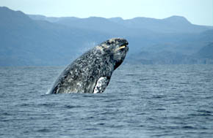
1.
Some people call these whales “devil fish.”
Photo credit: Merrill Gosho, NOAA
ANSWER: Gray whale

Slide 3
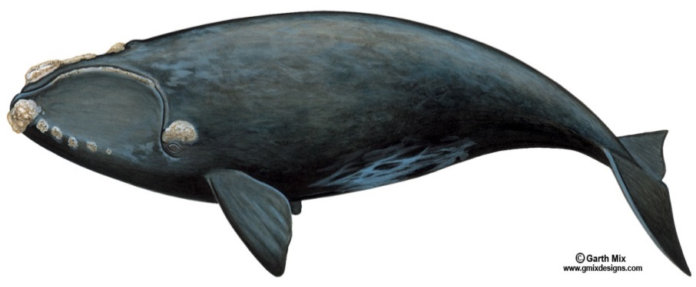
2.
This whale comes to warm Florida waters to have its babies (calves) every winter.
ANSWER: Right whale

Slide 4
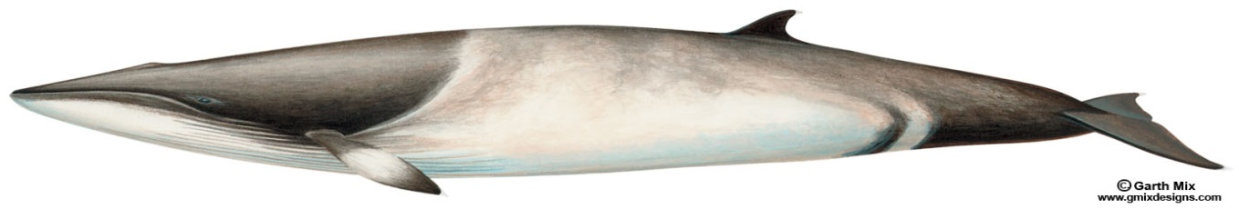
3.
These baleen whales can swim very fast.
ANSWER: Minke whale

Slide 5
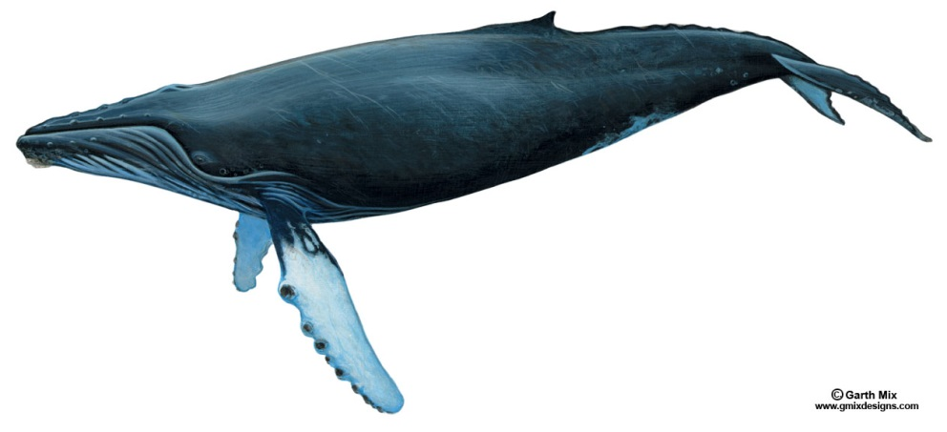
4.
Each of these whales has a different white pattern under its tail fluke.
ANSWER:
Humpback whale

Slide 6
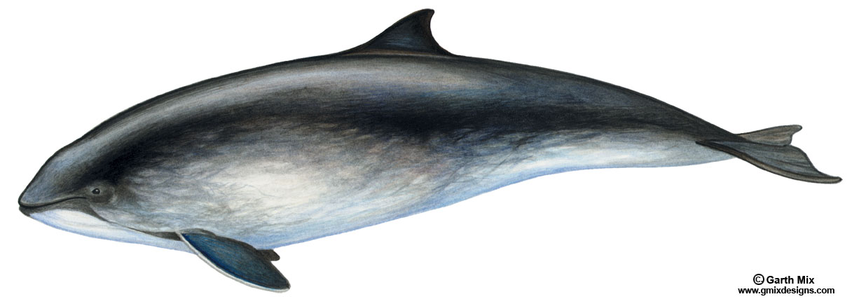
5.
These toothed whales are sometimes called “puffing pigs.”
ANSWER: Porpoise

Slide 7
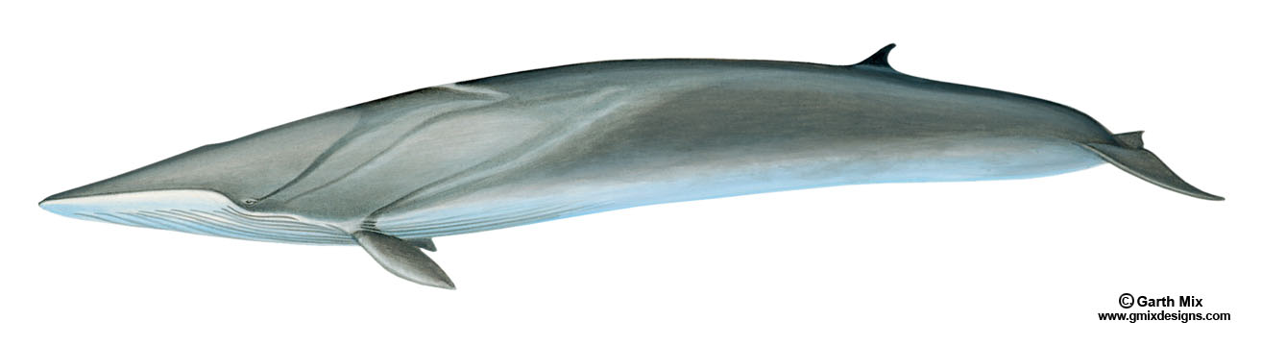
6.
This whale is sometimes called a finback whale.
ANSWER: Fin whale

Slide 8
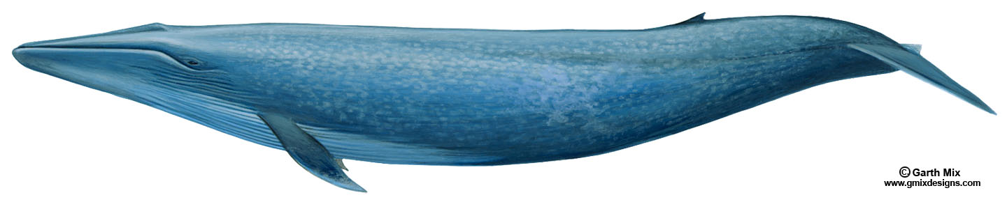
7.
This whale is the biggest animal in the world.
ANSWER: Blue whale

Slide 9
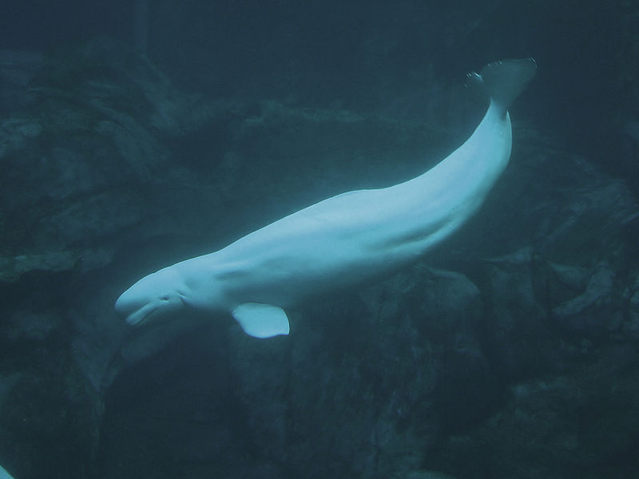
8.
This whale is born dark gray but becomes snowy white as it grows up. It is often called “the white whale.”
Photo credit: Greg Hume
ANSWER: Beluga

Slide 10
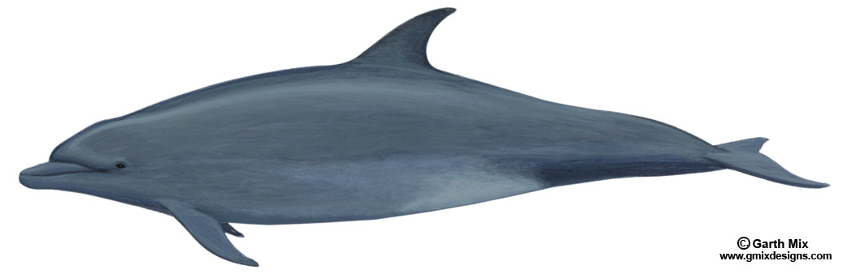
9.
This marine mammal looks like it is smiling.
ANSWER: Dolphin

Slide 11
10.
This whale has a white chin.
ANSWER: Bowhead whale

Slide 12
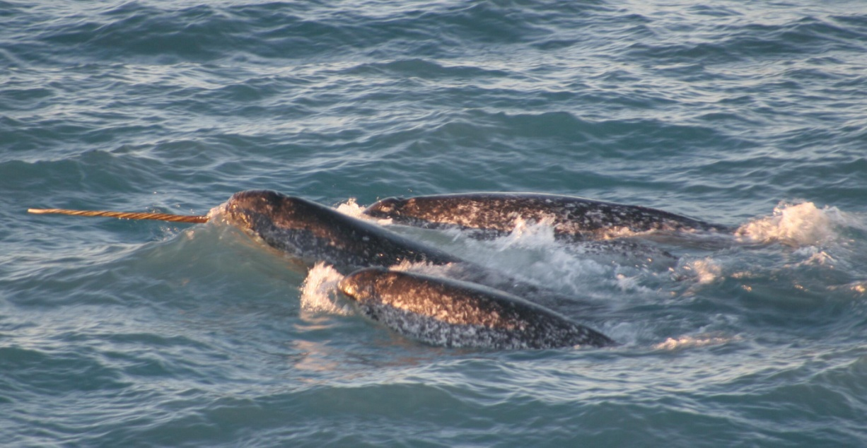
11.
These whales have one long tooth that grows out of the front of their jaws.
ANSWER: Narwhal
Photo credit: NOAA/University of Washington

Slide 13
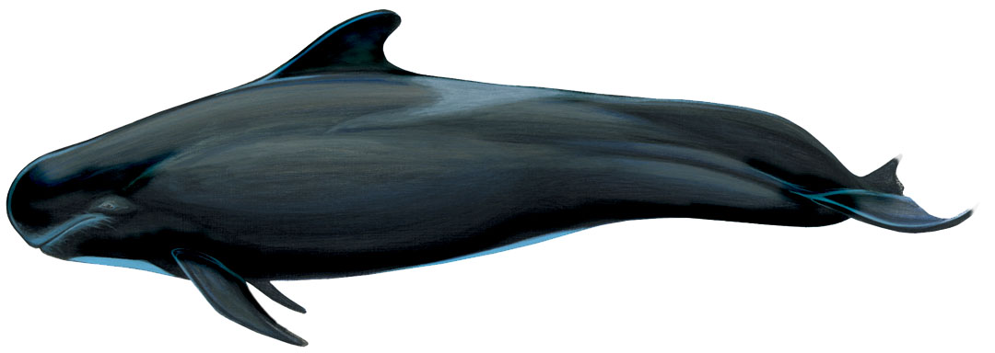
12.
This toothed whale has a large, round head.
ANSWER: Pilot whale

Slide 14
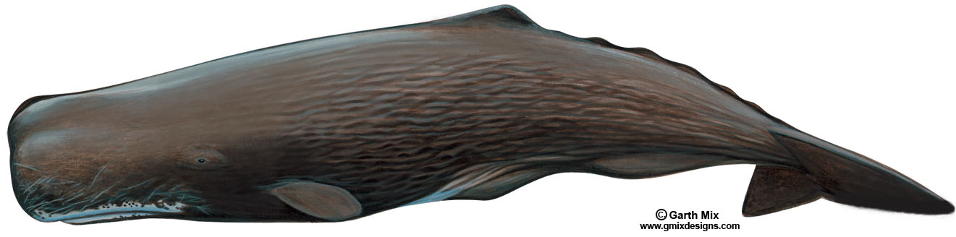
13.
This whale is the largest toothed whale.
ANSWER: Sperm whale

Slide 15
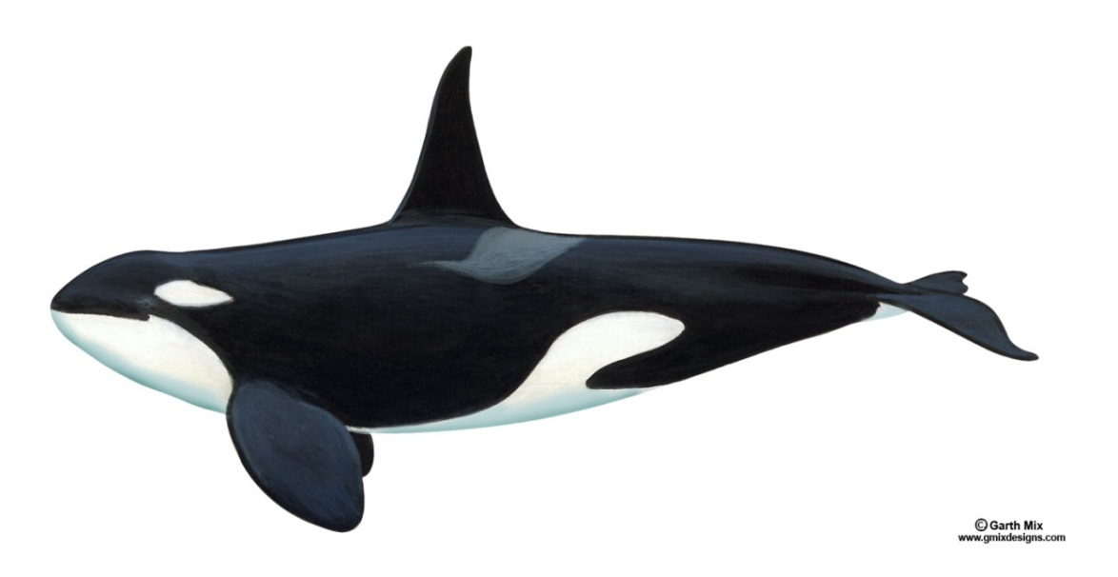
14.
This whale is also called “killer whale.”
ANSWER: Orca

Slide 16
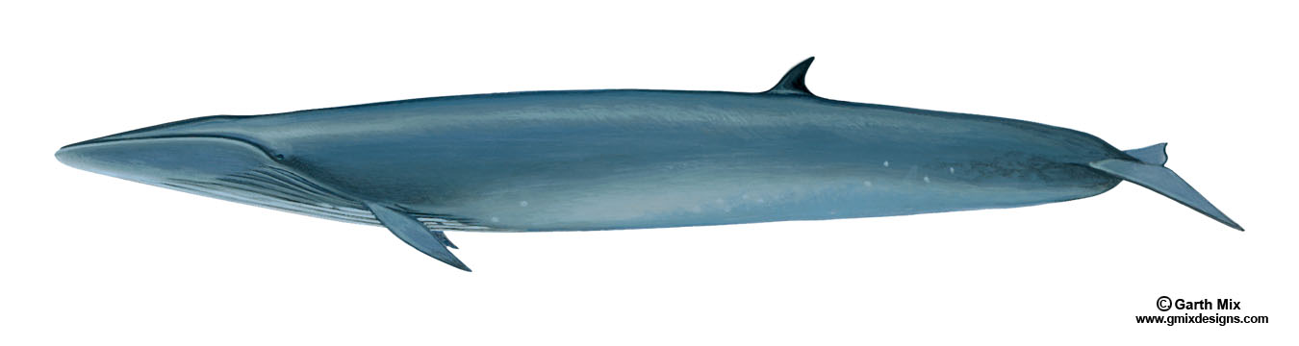
15.
These whales are often bitten by cookie cutter sharks. That leaves circle-shaped scars on their skin.
ANSWER: Sei whale

