Slide 1


Manatee adaptations to life in a watery world

Slide 2
What is adaptation?
Notes:
STUDENTS
Have the students explain what they think “adaptation” means.
TEACHER
The biological definition is a trait or characteristic that improves an organism’s ability to survive and reproduce in its environment.
Example: Animals’ teeth are different depending on their diet. Lions and sharks, which are carnivores, have razor sharp teeth good for tearing meat, but cows, which are herbivores, have teeth that are good for grinding plant material. Humans are omnivores, so they eat both plants and animals; thus, they have both sharp teeth and grinding molars.

Slide 3
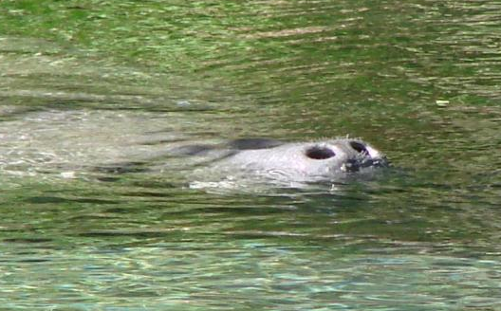
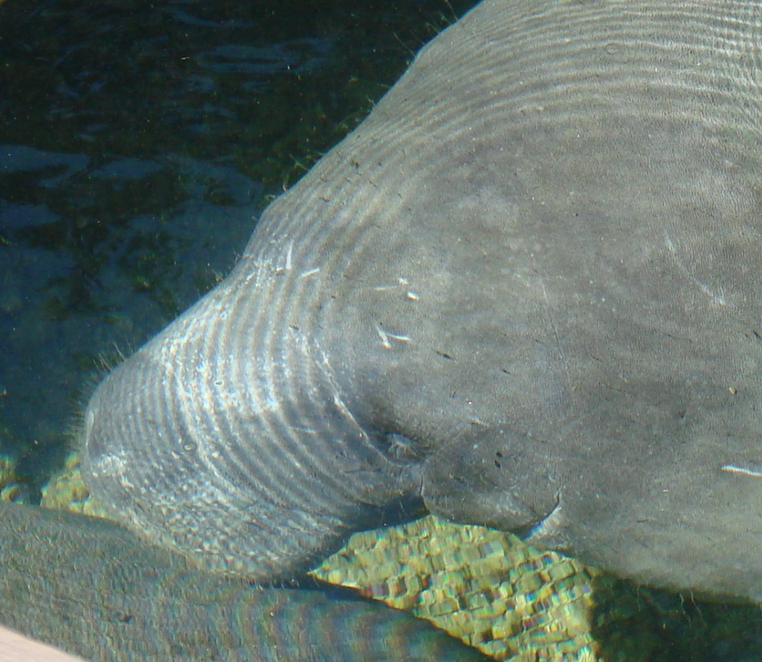
Do manatees breathe under water?
All photos by Maia McGuire
Notes:
STUDENTS
Have the students discuss whether manatees breathe underwater like a fish or hold their breath like a person.
When they determine that manatees hold their breath, have them guess how long they can hold their breath.
TEACHER
Manatees breathe air just like humans, so they hold their breath. Their special adaptation is that they can close their nostrils so that water does not get into their lungs, just like we hold our nose when we dive underwater. On the slide, one picture shows the manatee’s nostrils open, and the other shows them closed. When manatees surface to breathe, only their nose has to come out of the water so that they can open their nostrils and take another breath.
Manatees can hold their breath for up to 20 minutes, while the average person can only hold their breath for 30–45 seconds.

Slide 4
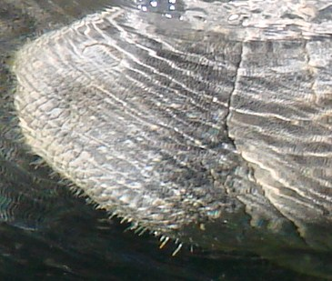
Whiskers: What are they for?
Notes:
STUDENTS
Have the students explain what five senses a person has.
Have the students discuss what they think manatee whiskers are used for.
TEACHER
Manatees use their whiskers as a sensory organ, much like a cat does. They can feel things (sense of touch) with their whiskers. The whiskers are actually more sensitive than the tips of our fingers.

Slide 5
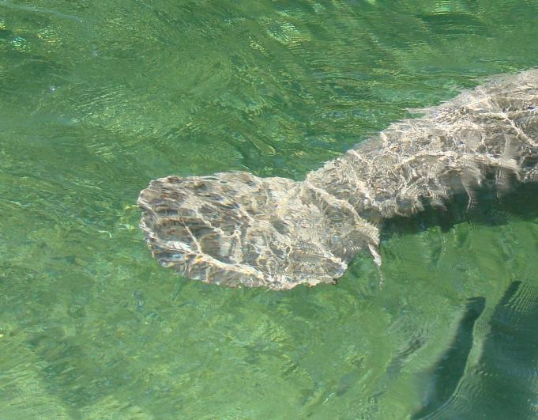
How do manatees swim?
Notes:
STUDENTS
Have the students explain what body part of the manatee is shown in the slide.
Have the students discuss how they think the manatee swims through the water.
TEACHER
The manatee moves through the water by moving its tail up and down.
On average, manatees swim at about 3 to 5 mph. This is about the same speed that people can walk. However, they have been known to swim at almost 20 mph in short bursts.

Slide 6
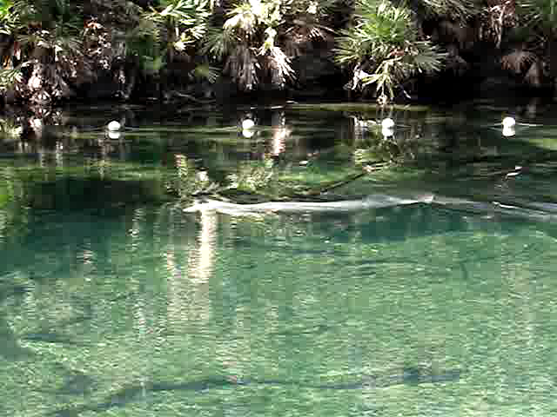
A manatee in motion
Notes:
TEACHER
Play the movie showing how a manatee swims through the water.
Explain to the students that this manatee is swimming quite fast!
Encourage them to watch the tail pumping up and down. Point out that because the tail is wide, it generates a lot of power.
Compare the speed of a person swimming with bare feet to that of a person swimming with swim fins or flippers. Who can swim faster?

Slide 7
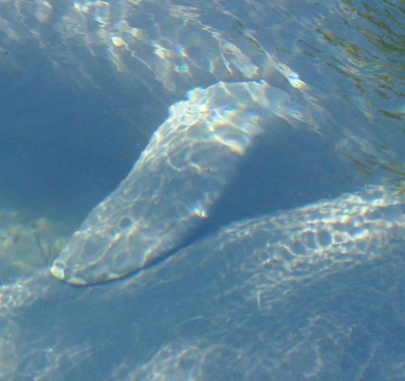
What is my flipper for?
Notes:
STUDENTS
Have the students explain how manatees use their front flippers.
TEACHER
Front flippers help manatees steer and change direction when they are swimming. Point out that the students probably noticed this in the movie clip.
Point out the manatees’ toenails, which are similar to those on elephants’ feet.
Manatees can use their flippers (and toenails) to help them collect the plants that they like to eat, and to get the plants into their mouths.

Slide 8
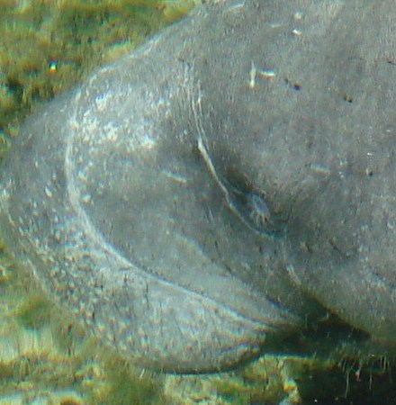
What does a manatee use its lips for?
Notes:
STUDENTS
A manatee’s snout looks like an elephant trunk. Have the students discuss what they think are the possible reasons for the similarity.
TEACHER
Their snouts enable them to collect food easily. Manatees can eat plants that are underwater or floating on the surface. Their lips are muscular and can grab plants and move the plants into the manatee’s mouth.

Slide 9
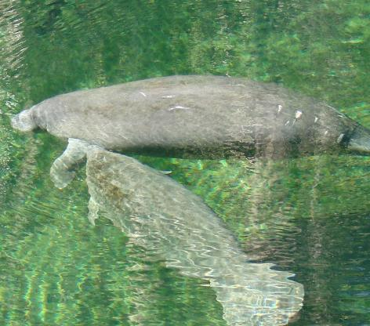
Do baby manatees use their lips to get food?
Notes:
STUDENTS
Have the students discuss what a mother manatee provides for her calf.
TEACHER
A manatee calf nurses from under the mother’s flipper, so even baby manatees use their lips to help them get food—in this case, to get milk from the mother manatee.

Slide 10
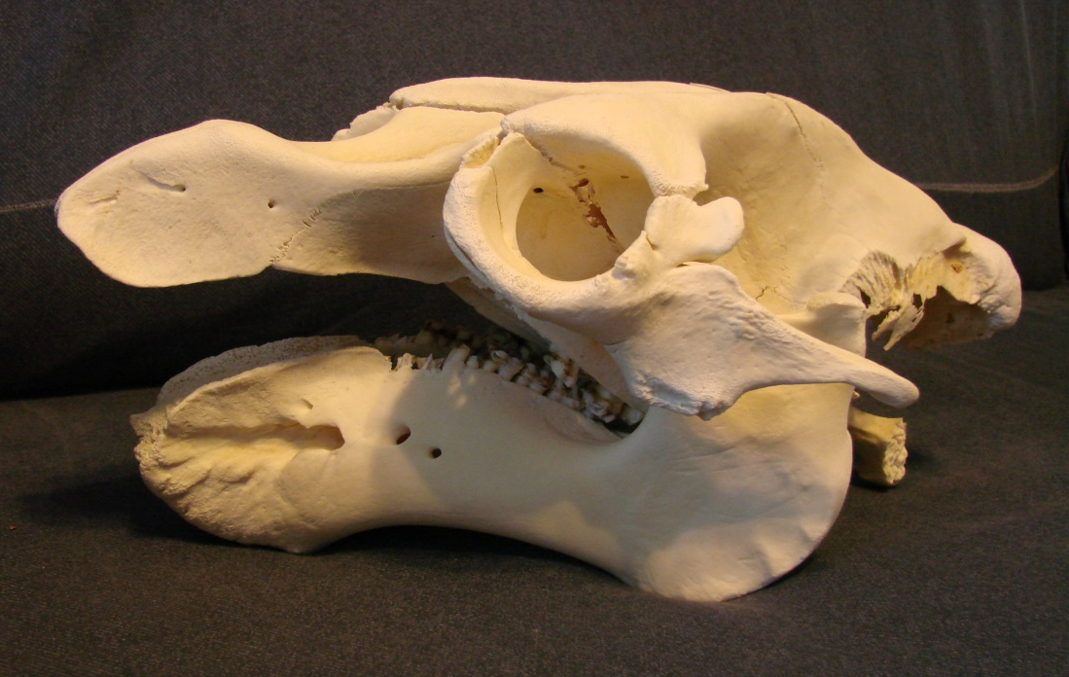
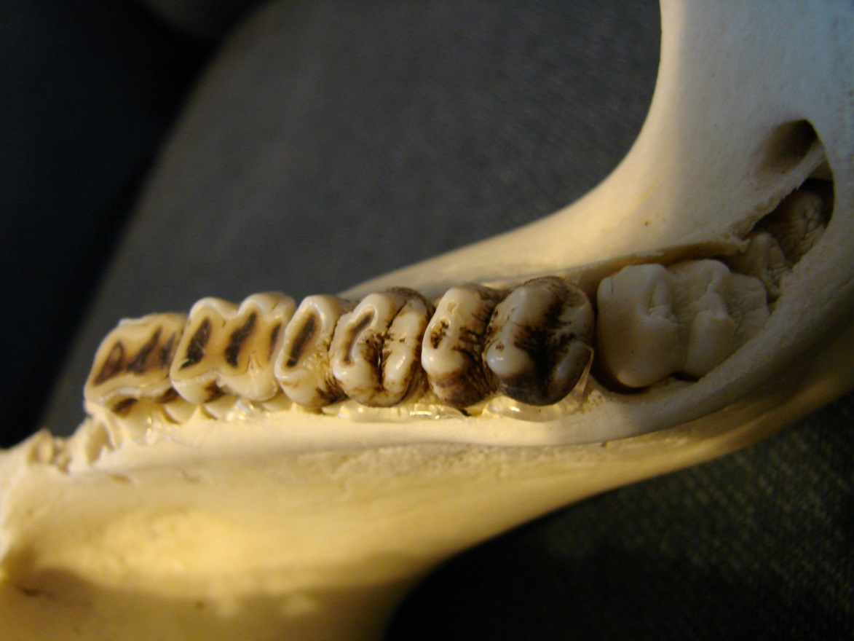
What kind of teeth do manatees have?
Teeth in a manatee’s lower jaw
A manatee skull
Notes:
STUDENTS
• Have the students discuss which of their teeth most resemble a manatee’s teeth.
TEACHER
• Humans have different types of teeth, because we eat many different types of food (we are omnivores—we eat both meat and plants). Our incisors are used to cut food. Our canine teeth (cuspids) are used for tearing food. The bicuspids behind the canines are used for crushing food. Our molars are used for grinding food.
• Since manatees are herbivores (they only eat plants), they only have molars, which they use to grind up the plants before they swallow them.
• Unlike us, manatees grow new teeth in the back of their mouths all the time. As their older teeth get worn down from chewing those tough and sometimes sandy plants, they fall out. The rest of the teeth move forward in the jaw, and new teeth start to form in the back. We say that manatees have “marching molars.” Manatees never have to worry about running out of teeth!

Slide 11
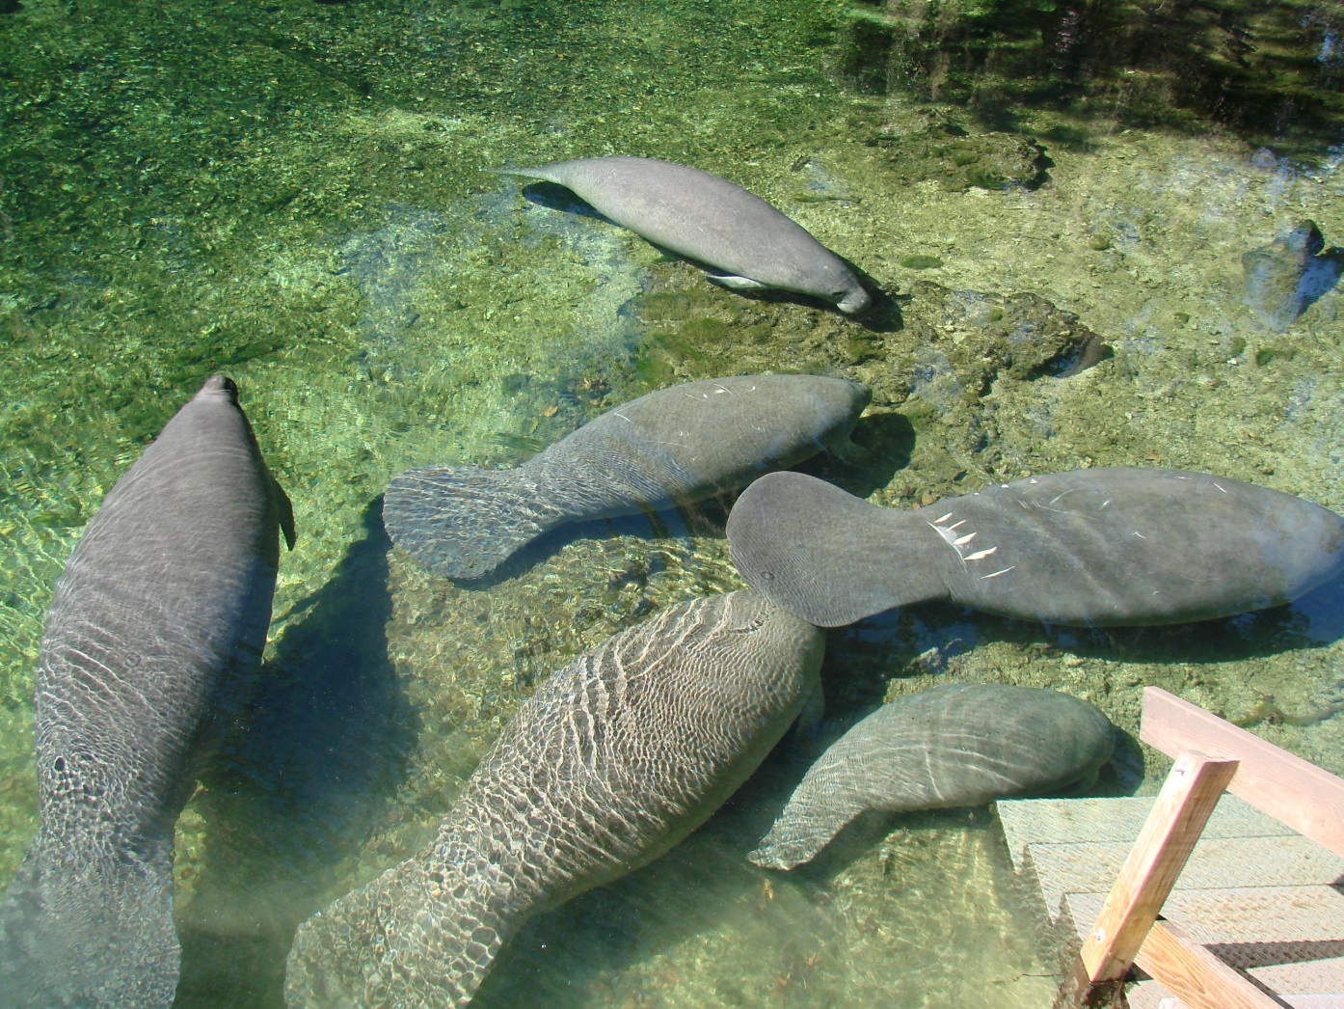
How many manatee adaptations can you list?
Notes:
See how many groups of students can list all six adaptations mentioned in the presentation. How does a manatee use its nose, whiskers, lips, flippers, and tail? How are its teeth special?

